Slide 1
QuickDoc
Sprint 2 — UML Sequence Diagrams
CS691 Capstone Project | Team 4 | Pace University
Professor Yuri Chernak, PhD

Slide 2
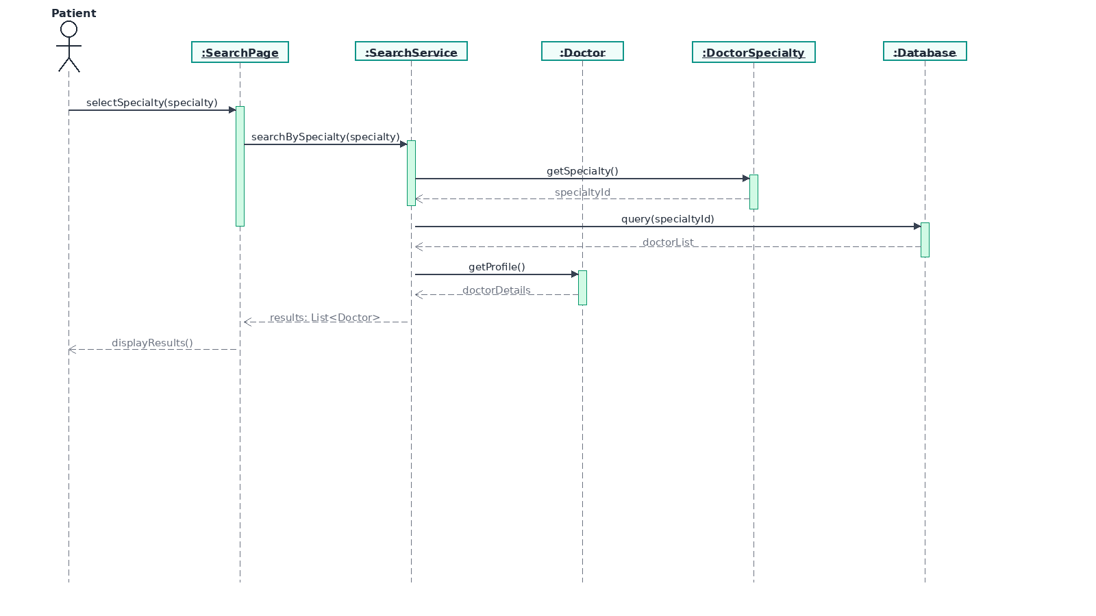
02.01 — Search by Specialty
Story Outline:
1. Patient navigates to the Search Page
2. Patient selects a medical specialty from dropdown
3. SearchPage sends request to SearchService
4. SearchService looks up the specialtyId via DoctorSpecialty
5. SearchService queries Database for doctors with that specialty
6. Doctor profiles are retrieved and returned
7. Search results are displayed to the Patient
QuickDoc — Sprint 2 Sequence Diagrams | Team 4 | CS691 Capstone

Slide 3
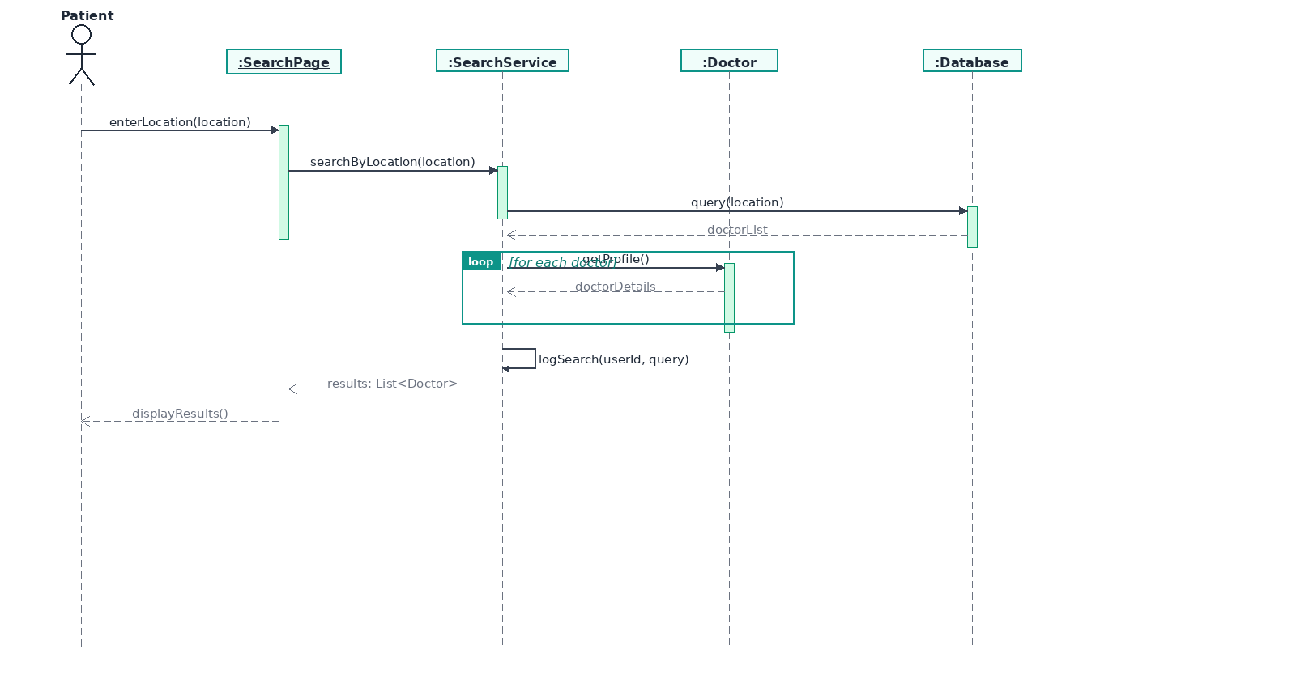
02.02 — Search by Location
Story Outline:
1. Patient enters a city/location in the search field
2. SearchPage forwards the location to SearchService
3. SearchService queries the Database for doctors in that area
4. For each doctor found, profile details are retrieved
5. SearchService logs the search query for analytics
6. Results list is returned and displayed to the Patient
QuickDoc — Sprint 2 Sequence Diagrams | Team 4 | CS691 Capstone

Slide 4
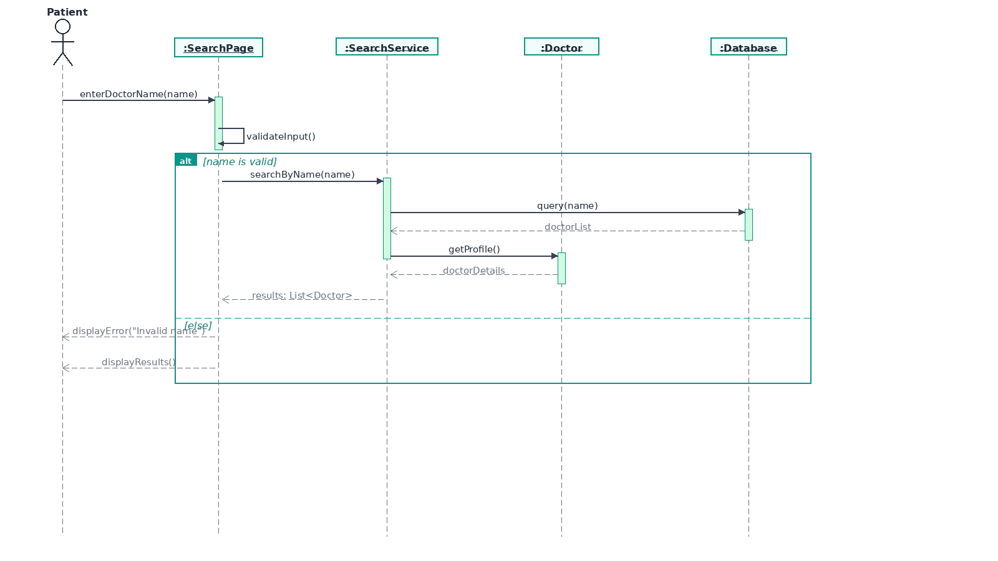
02.03 — Search by Name
Story Outline:
1. Patient enters a doctor's name in the search field
2. SearchPage validates the input
3. [alt] If valid: SearchService queries Database by name
- Doctor profiles are retrieved and results displayed
4. [else] If invalid: error message is shown to Patient
QuickDoc — Sprint 2 Sequence Diagrams | Team 4 | CS691 Capstone

Slide 5
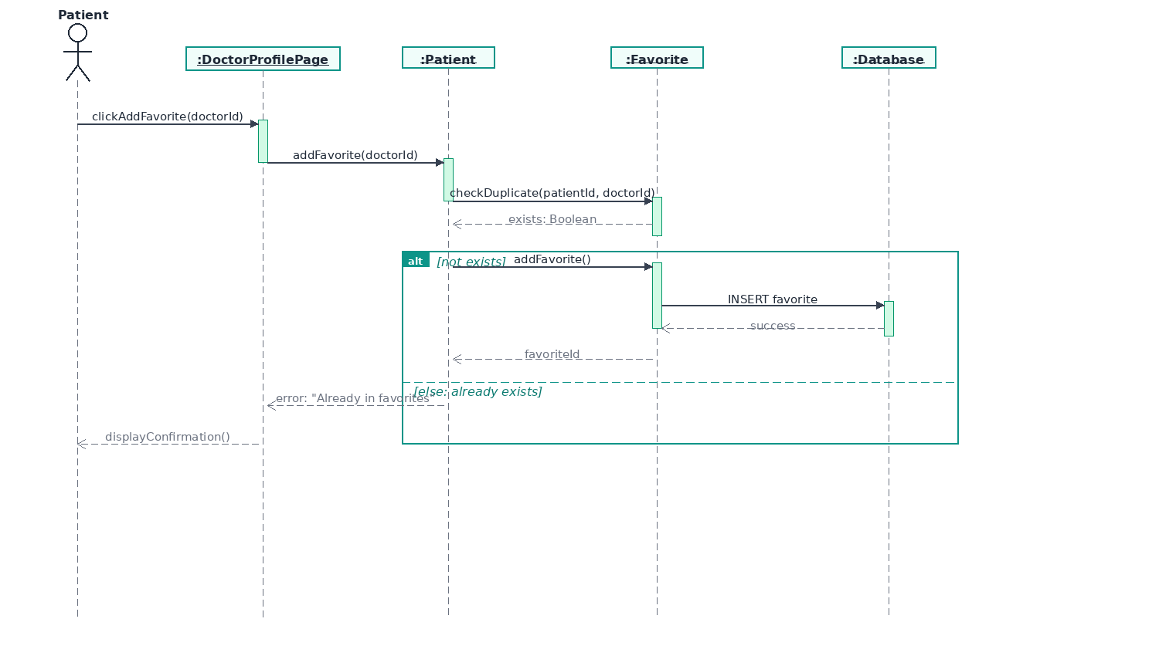
02.04 — Add to Favorites
Story Outline:
1. Patient clicks 'Add to Favorites' on a Doctor Profile
2. DoctorProfilePage calls Patient.addFavorite()
3. System checks for duplicate via Favorite.checkDuplicate()
4. [alt] If not exists: new Favorite record is inserted in Database
5. [else] If already exists: error message is displayed
6. Confirmation is shown to the Patient
QuickDoc — Sprint 2 Sequence Diagrams | Team 4 | CS691 Capstone

Slide 6
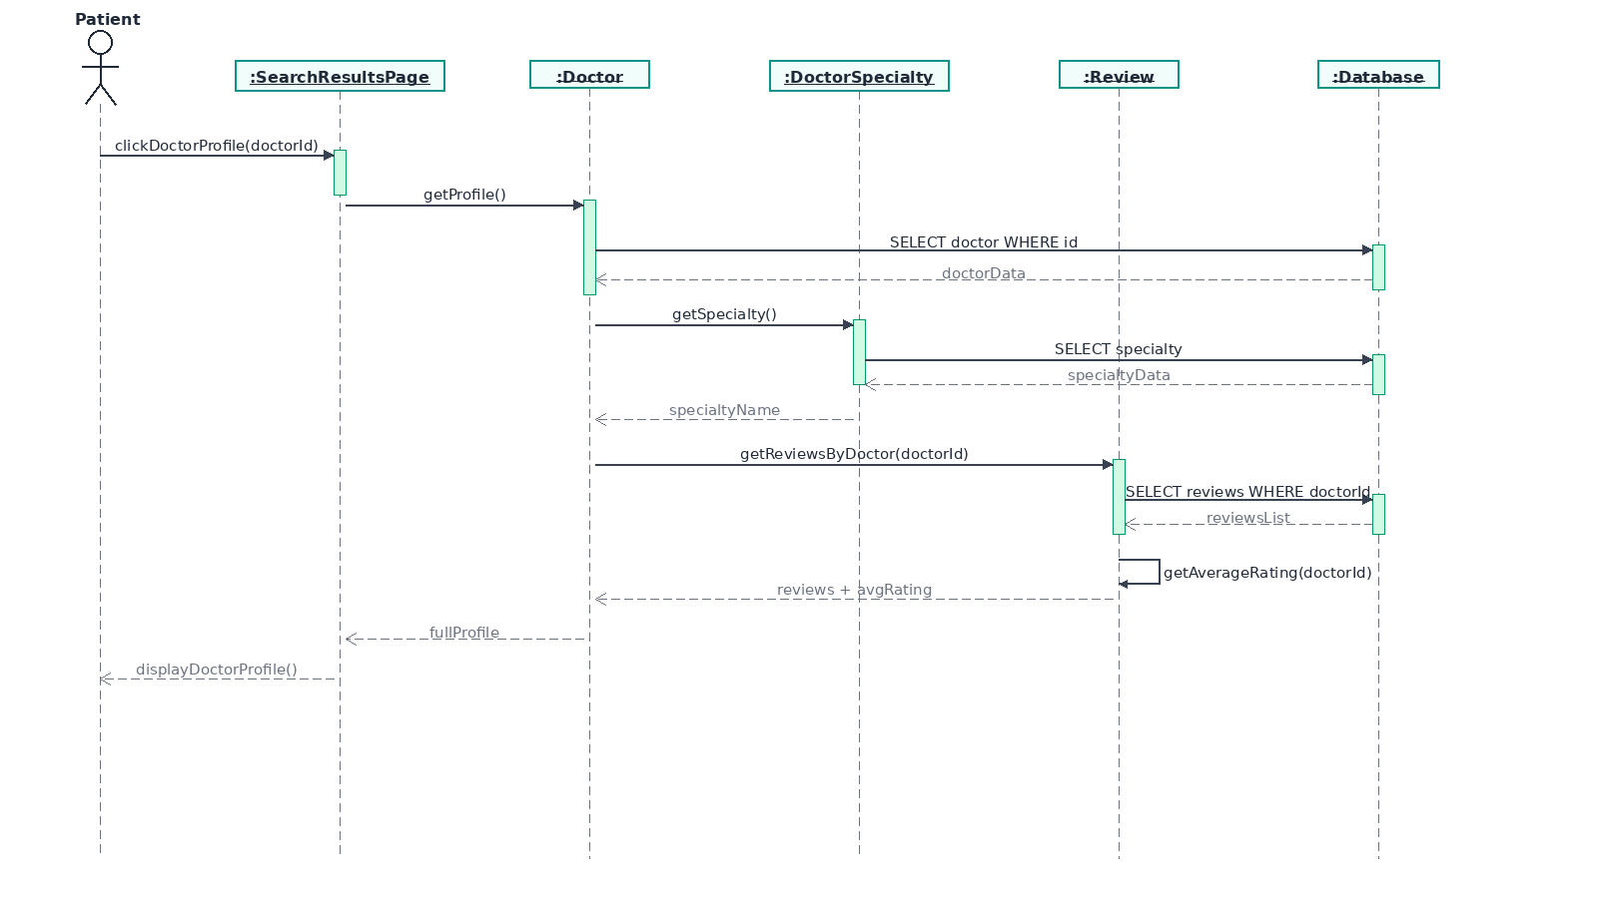
02.06 — View Doctor Profile
Story Outline:
1. Patient clicks on a doctor from search results
2. System retrieves Doctor profile from Database
3. Doctor's specialty details are fetched via DoctorSpecialty
4. Reviews for the doctor are retrieved via Review class
5. Average rating is calculated (self-message)
6. Full profile with reviews and rating is displayed
QuickDoc — Sprint 2 Sequence Diagrams | Team 4 | CS691 Capstone

Slide 7
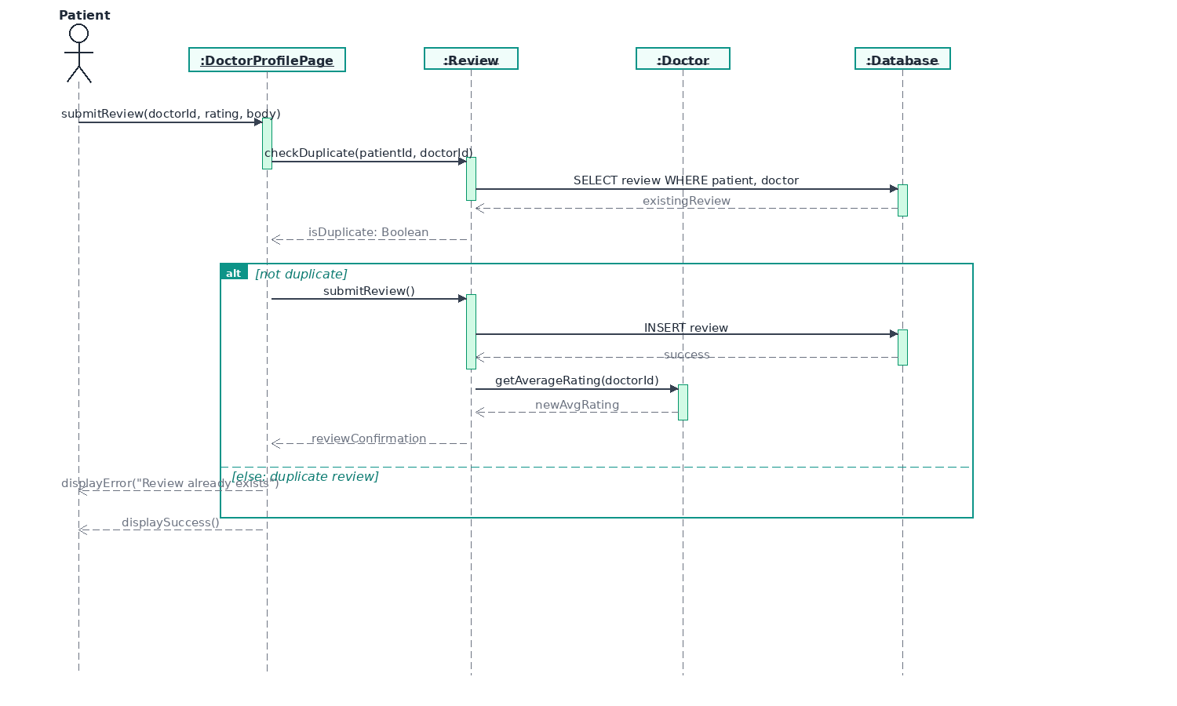
05.01 — Submit Review
Story Outline:
1. Patient submits a review (rating + body) on Doctor Profile
2. System checks for duplicate review via Review.checkDuplicate()
3. Database is queried for existing review by same patient
4. [alt] If not duplicate: review is inserted into Database
- Doctor's average rating is recalculated
5. [else] If duplicate: error message is shown
6. Success confirmation displayed to Patient
QuickDoc — Sprint 2 Sequence Diagrams | Team 4 | CS691 Capstone

